Slide 1

Creating a Young Person’s Guarantee for Greater Manchester
Business Roundtable
Tuesday 4th August
10-11am
taskforce@greatermanchester-ca.gov.uk
#GMYPG

Slide 2
Today’s Roundtable Discussion
Session Facilitators
Diane Modahl
CEO - DMSF
Chair - GM Young People's Taskforce
Laura-Jane Rawlings
CEO – Youth Employment UK
Nicola McLeod
Principal Skills Manager - GMCA
10.00 – 10.05am
Welcome, housekeeping, facilitator introductions
10.05 – 10.15am
Introducing the Young Person's Guarantee
• Background and context
• Vision and objectives
• Local and National responses so far
• Summaries from our the first youth consultation
10.15 – 10.55am
Roundtable Discussion
• Challenges facing businesses
• Additional support needed by employers
• The role of Apprenticeships and Traineeships
• Working with the education system
• Increasing inclusion and diversity within the workforce
#GMYPG
10.55 – 11.00am
Next Steps
• The roadmap to delivering the Guarantee
• Further consultation / staying involved
Notes:
Possibly introduced by either Nicola / Jack / LJ
Facilitators to be introduced by the speaker.
Mention that many Enterprise Coordinators are on the call and will be on hand to support and arrange follow up discussions with schools and colleges if required.

Slide 3
Our Housekeeping Rules
Please keep your microphone on mute throughout the meeting (unless you have been invited to speak)
If you wish to speak, please use the hand icon and wait to be invited into the conversation by one of the session facilitators
Use the chat function to share your views and comments – especially if we don’t get round to hearing from you during the session
Please try to be as succinct as possible when speaking or using the chat function – we have limited time and want to ensure everyone has an opportunity to be heard!
Please note: this session is being recorded.
Notes:
Possibly introduced by either Nicola / Jack / LJ
Facilitators to be introduced by the speaker.
Mention that many Enterprise Coordinators are on the call and will be on hand to support and arrange follow up discussions with schools and colleges if required.

Slide 4
What we know about the current situation and how it has effected our young people
Social and Digital Exclusion
According to the Sutton Trust, only a third of students took part in online lessons offered by their school during the first stages of lockdown, whilst more than two thirds of disadvantaged young people were not considered to be equipped with sufficient access to digital resources to support their learning at home.
Poorer Health and Wellbeing
According to the mental health charity YoungMinds, 83% of young people with an existing mental health condition said the loss of routine, school closures, exam cancellations and the health concerns associated to the virus were all factors in worsening their mental health and increasing their anxieties about the future.
Greater Risk of Poorer Transitions
Job vacancies during the lockdown period dropped by more than two-thirds, with the fall in apprenticeship vacancies running at 80%. According to the Institute of Student Employers, 68% of businesses also cancelled work experience and taster opportunities, though many colleges and universities have reported an increase in applications for September.
Increased Economic Inequalities
Those under the age of 25 have already experienced greater levels of job and labour market displacement because of COVID-19 – they are 2.5 times more likely to be working in sectors that have "shut down" and are more likely to have been made redundant, or placed on furlough, when compared to older age groups.

Slide 5
Our ambitions for the Young Person’s Guarantee in GM
Our Vision – to secure young people’s future prosperity in GM
Protecting those in education, employment and apprenticeships, who face immediate challenges and displacement because of the pandemic
Promoting current and emerging opportunities that help to support young people to be ready for life, learning and work
Progressing young people through quality education, employment and training across the city-region
The Challenge – to design a meaningful Guarantee for our young people
The Task Force
Chair – Diane Modahl
Youth Advisory Group
Co-designed with young people
Supported by partners and Leaders
Asset-based / evidence-led
Outcomes-focused
Taskforce membership will be determined by these principles and the needs of our young people
The Response –
to implement a differentiated offer that supports and improves young people’s outcomes
Guaranteed work shadowing opportunities
Guaranteed College places for all 16-18 year olds
Employment support for those who need it, including self-employed
Quality careers education, information, advice and guidance (CE/IAG)
A comprehensive travel offer that builds on the principles of Our Pass
Increased digital connectivity, access and inclusion
More social action, community and cultural engagement opportunities
Subsidised jobs for those at risk of long-term unemployment
Improved access to digital and physical mental health services
More HE and adult learning opportunities
Retraining and re-skilling for 19+ year olds
Continued high quality Apprenticeship availability
Notes:
This slide outlines the following aspects of the Guarantee:
1. Its mission statement
2. Its objectives
3. The Taskforce’s main responsibility and key working principles
4. The outputs and deliverables we know young people have already asked for
The Taskforce, including its membership, should be constituted by the consultation process. It must respond to what our young people are telling us (from 11-30 years old) and utilise the knowledge, expertise and resources of organisations that are best equipped to deliver meaningful change and action. This is likely to include a range of public, statutory and voluntary organisations, alongside key business groups and representatives.
What our young people have already asked for – our initial consultation, supported by local and national research, tells us that young people want to benefit from a Guarantee that protects and promotes a wide range of opportunities. This list is not exhaustive, but can function as an indicator for what the Guarantee may include and/or incorporate.

Slide 6
What is already happening in GM to support the recovery process for young people
Local and national Government have already started to respond to the issues caused by the pandemic…
Government announcements in response to Covid-19:
Keeping Connected
Free bus travel for 16-18 year olds and Care Leavers up to age 21 via the Our Pass scheme
Removal of peak-time restrictions for disabled young people on buses and metrolink
Fast-tracking the Apprentice Bike Offer for GM Apprentices in Key Worker roles
Distribution of digital technology to 1,700 vulnerable young people in GM via the GM Technology Fund
Providing additional technology and bus travel for other vulnerable groups via the Prince’s Trust (e.g. NEET, Care Leavers)
Distribution of Cultural Engagement Packs to over 20,000 13-20 year olds in GM who face accessibility issues
Job retention scheme extended to Oct 2020
Introduction of the Kickstart employment scheme for 16-24 NEET
Staying
Well
Supporting the rollout and expansion of Digital Mental Health Services for young people across GM with the GMH&SCP
Back to school & college resource packs made available for primary, secondary, FE and SEND students
Further expansion of the GM Mentally Healthy Schools Programme from the start of the 2020/21 academic year
Targeted support through the GM Work & Health programme
10,000 more University places made available from Sept 2020
Making Effective Transitions
Targeted careers resources and support for young people, schools and colleges via Bridge GM and GMACS
A re-purposed National Citizen Service for 15-17 year olds that focuses on digital and physical volunteering and social action
An expanded C4L offer to support the re-integration of young people into schools and colleges
Targeted support for Y11s and Y12s at risk of becoming NEET to support their transition into further education and training
GM Colleges offering guaranteed places, extended learning hours and opportunities to sit missed examinations
Additional support and outreach activity for prospective HE learners offered by GM Higher
Innovative AEB commissioning that will offer more flexible learning opportunities to young adults
Additional funding for Apprenticeships and Traineeships
Digital technology being made available to vulnerable learners
Removing Economic Inequalities
Development of an ILM/incubator scheme to support the recruitment and retention of young people in work
Improved identification and resource planning for NEET young people aged 18+ with LAs, VCSEs and DWP
Funding employers/providers to remove barriers to Apprenticeships for young people and under-represented groups
Offering additional support to young apprentices who have been made redundant because of COVID-19
Safeguarding supported employment opportunities for those young people with learning difficulties and SEN
Continued development and delivery of a Care Leavers Guarantee, including a public sector employment offer
Continuing to promote and develop employer encounters through Bridge GM and Meet Your Future
More funding for young adults to remain in education
Introduction of new physical health initiatives (e.g. obesity)
…but what else do we need to do to better support our young people in Greater Manchester?
Notes:
This is a slide for the audience to reflect on as part of the roundtable discussion.
It’s aim is to highlight that both GM and Government are already making significant policy and programme interventions to help address the challenges faced by young people and the wider sectors that support them. Yet we know much more is needed if we are to protect and support all young people in GM, particularly those who are already more disadvantaged and marginalised.

Slide 7
Incentives to help employers create more work opportunities for young people
The Chancellor has recently announced several incentives to encourage employers to create more work opportunities for young people over the next six months:
 | Cost to employer | Financial incentive | Training support | Duration | Age | Eligibility
Kickstart Scheme | Wages are subsidised up to 25 hrs per week at NMW rate for age | Wage subsidy + no employer NI contribution | To be confirmed | 26 weeks | 16-24 year olds | Young people must be in receipt of Universal Credit
Apprenticeships | Wages of a least £4.15 p/hr + plus co-investment (or Levy funds) | £1,500-3,000 + no employer NI contribution | 20% off-the-job training linked to an Apprenticeship Standard (+ maths & English where required) | Minimum of 12 months | 16+ | Incentives payable on new hires or apprentices progressing to a higher level of learning
Traineeships | None – placements are unpaid | £1,000 | Employability training + maths & English qualifications | Minimum of 100 hours – to be delivered over 6 weeks to 6 months | 16-24 year olds | Young people cannot have higher than a L3 qualification.
Industry Placements (as part of T-levels) | None – placements are unpaid | £750 – optional payment offered by some providers | 2-year occupational course equivalent to 3 A-levels | 315 hours (approximately 45 days) | 16-19 year olds | Young person must be enrolled on a T-level programme
Notes:
Feedback received from the first

Slide 8
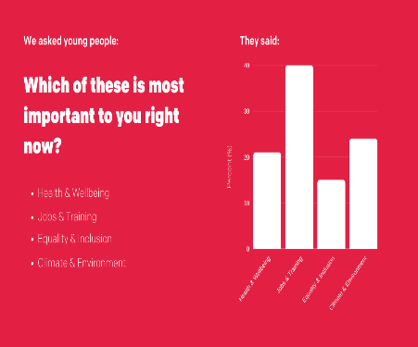
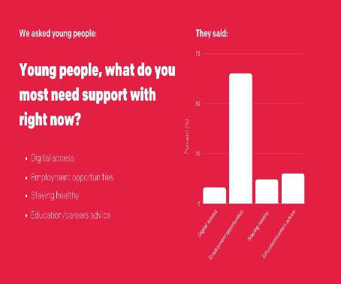
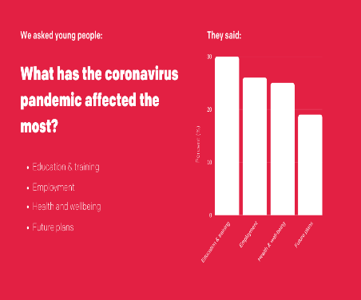
What our young people have been telling us about their issues and concerns
On 25th June we carried out our first consultation event with young people to collect their views about the pandemic and how a Guarantee could support their futures. Prior to the event, young people were asked the following three questions:
Which of these is most important to you right now?
What do you most need support with right now?
What has the coronavirus pandemic affected the most?
Health & Wellbeing – 21%
Jobs & Training – 40%
Equality & Inclusion – 15%
Climate & Environment – 24%
Digital Access – 8%
Employment Opportunities – 65%
Staying Healthy – 12%
Education / Careers Advice – 15%
Education & Training – 30%
Employment – 26%
Health & Wellbeing – 25%
Future Plans – 19%
Notes:
Feedback received from the first

Slide 9
Themes and issues for businesses to consider
1
2
3
4
5
Challenges Facing Businesses
We know many businesses face unprecedented levels of challenge due to the Coronavirus, particularly in relation to recruitment, retention and physical distancing
Support for Employers
The Government has made a range of financial support available to employers, including a number of schemes that aim to support unemployed young people
Apprenticeships and Training
Many young people will require additional support and training to help them progress into current and emerging job opportunities.
Working with Education
Labour market volatility is likely to increase young people’s participation in the education system over the short-term, as well as influence future career choices and aspirations.
Inclusion and Diversity
In times of economic recession, the disadvantage gap can often increase, making it even harder for those with pre-existing barriers to succeed.
How are these challenges affecting the way your business operates and what impact is this having on young people?
What additional support can be offered to help employers recruit and retain young employees?
How can we encourage more businesses to engage with apprenticeships and other pre-employment programmes?
How should employers be encouraged to engage with young people who are in the education system?
How can we ensure employment opportunities remain accessible to those who are most disadvantaged?
Notes:
Education is a concern for many young people. Prior to the live consultation, we received 19 questions about education, in addition to four during the live feed. The key themes and issues are summarised below:

Slide 10
The Roadmap for delivering the Young Person’s Guarantee
JUNE 2020
Appointment of Taskforce Chair
Initial Consultation on the Guarantee with young people
Next Steps:
Keep informed – we will keep you updated about the progress of our work over summer, including opportunities for further consultation, feedback and engagement. Check the website!
Tell us what you think – you can contact the Team at any point to share your views and insights.
JULY 2020
Further Consultation on the Guarantee with partners and stakeholders
Establishment of a Youth Advisory Group (YAG)
AUGUST 2020
Establishment of the Taskforce
Ongoing communications and engagement with young people and partners
Design and Development work – co-produced with the YAG
taskforce@greatermanchester-ca.gov.uk
www.greatermanchester-ca.gov.uk/what-we-do/young-people/youth-task-force-and-young-person-s-guarantee/
SEPTEMBER 2020
Launch of the Guarantee
Notes:
These are the indicative timescales that the Project Team and Taskforce will work towards.
We see education as a critical part of the Guarantee and want to continue to work with you to shape and develop the Guarantee.

Slide 11
Thanks for joining us!
taskforce@greatermanchester-ca.gov.uk
#GMYPG

