Slide 1
Social Housing Digital Inclusion Pilot Programme- Research Sharing Series Innovative ways of working to empower people to thrive
Professor Simeon Yates, University of Liverpool
Beena Puri, Innovation and Partnerships Lead, Greater Manchester Combined Authority
#FixTheDigitalDivide

Slide 2
GMCA Social Housing Pilot
Prof. Simeon Yates
University of Liverpool

Slide 3
National Picture

Slide 4
User types – very similar to prior years
Descriptions
"Extensive (political)",
"Extensive",
"General (limited social media)",
"General (social media)",
"S&E",
"Limited (social media)",
"Limited (limited social media)"

Slide 5
Overall proportions
User types | Percent | Adults | Adults K | Adults M
"Extensive (political)" | 14.2 | 7501607 | 7502 | 7.50
"Extensive" | 22.5 | 11885662 | 11886 | 11.89
"General (limited social media)" | 4.9 | 2581722 | 2582 | 2.58
"General (social media)" | 14.3 | 7550318 | 7550 | 7.55
"S&E" | 17.5 | 9255229 | 9255 | 9.26
"Limited (social media)" | 12.2 | 6429948 | 6430 | 6.43
"Limited (limited social media)" | 6.6 | 3507245 | 3507 | 3.51
"Non-users" | 7.9 | 4178313 | 4178 | 4.18

Slide 6
Overall national / regional proportions
 | North East | Yorkshire and Humberside | North West | West Midlands | East Midlands | East of England | South West | South East | London | Scotland | Wales | Northern Ireland
1."Extensive (political)" | 9.9% | 12.4% | 14.3% | 15.2% | 11.2% | 11.9% | 16.3% | 14.8% | 19.6% | 10.7% | 14.7% | 15.6%
2. "Extensive" | 19.0% | 17.8% | 20.5% | 21.1% | 23.4% | 26.2% | 21.5% | 21.0% | 29.7% | 23.9% | 20.5% | 19.9%
3. "General (limited social media)" | 3.6% | 5.9% | 4.9% | 1.7% | 4.3% | 7.0% | 5.5% | 7.3% | 3.6% | 5.2% | 2.4% | 4.3%
4. "General (social media)" | 15.5% | 12.5% | 15.6% | 15.8% | 11.0% | 15.0% | 14.7% | 15.3% | 11.6% | 14.0% | 14.1% | 18.0%
5. "S&E" | 18.2% | 18.2% | 16.6% | 19.5% | 16.2% | 17.1% | 18.0% | 16.5% | 21.1% | 17.9% | 13.4% | 11.8%
6. "Limited (social media)" | 15.1% | 12.4% | 14.0% | 10.5% | 18.9% | 9.8% | 8.7% | 11.7% | 8.2% | 13.1% | 13.7% | 16.2%
7. "Limited (limited social media)" | 13.1% | 4.0% | 7.1% | 7.9% | 5.7% | 8.9% | 7.3% | 6.0% | 4.2% | 6.6% | 5.5% | 8.1%
8. "Non-users" | 5.7% | 17.0% | 7.0% | 8.2% | 9.3% | 4.0% | 8.1% | 7.3% | 1.8% | 8.7% | 15.7% | 6.0%

Slide 7
Limited users (both types) – key factors
As compared to other users
Unlikely to have post 18 education
More likely to be less confident about their literacy
More likely to have a health condition that impacts life
Likely to be in social housing as
Unlikely to own their home
Unlikely to be in private rented
Likely to be older
Very unlikely to be 35 to 45
Likely to be over 45
Note higher likelihood for some to be under 25 (need to explore – two types may differ by age)
Likely to be lower NRS grade
Very likely to be DE grade
Unlikely to be working

Slide 8
Compared to extensive users
Limited users are:
8.6 x LESS likely to have a post 18 education
2.1 x MORE likely to have below national median confidence in their literacy
1.8 x LESS likely to be home-owners
10.6 x MORE likely to be 65+ years old
4.3 x MORE likely to be NRS grades D&E
1.3 x LESS likely to be working
1.1 x MORE likely to be retired

Slide 9
Education
Extensive users are very likely to have a post 16 education
S&E and limited users are more likely to only have education up to 16

Slide 10
Literacy
S&E users have lowest literacy confidence

Slide 11
Social housing
Nationally poorer low or non-digital users are more likely to be in social housing.

Slide 12
Age
Limited users are likely to be much older

Slide 13
Socio-economic status
Limited users more likely to be in NRS grades DE

Slide 14
Non-users

Slide 15
Non-users most likely to have no education

Slide 16
Non-users likely to lack literacy confidence

Slide 17
Non-users more likely to have a health impact

Slide 18
Non-users more likely to be over 65+

Slide 19
Non-users more likely to be NRS D&E

Slide 20
What does this mean for GM?
About 40% of GM residents are likely to fall into these categories:
"S&E”
Young people with well below average digital skills, use, and access
"Limited (social media) / "Limited (limited social media)”
Older adults with well below average digital skills, use, and access
"Non-users"
These groups are:
Likely to have lower educational attainment
Be in social Grades DE
A large proportion are in social housing – especially those of lower SES

Slide 21
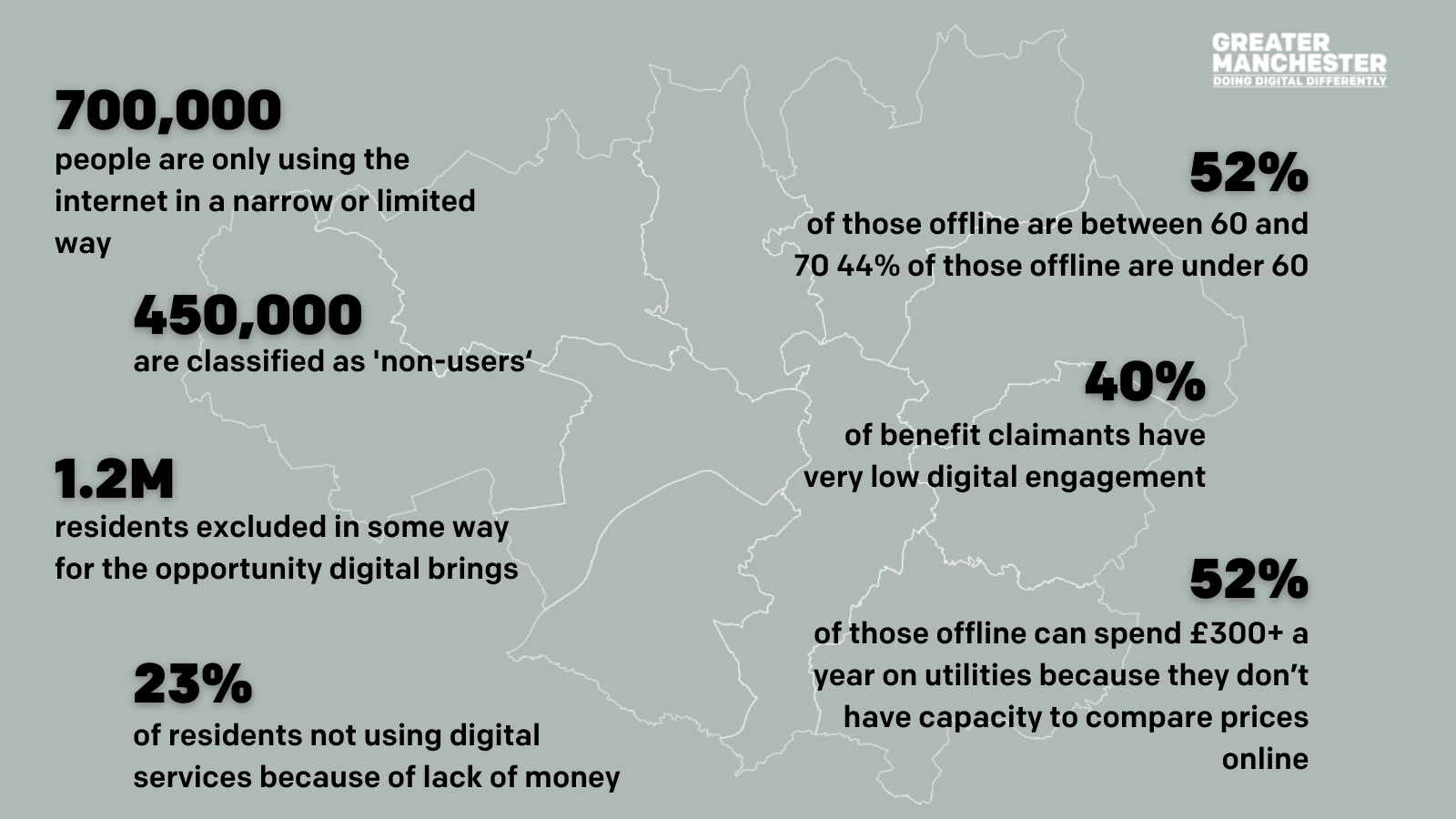
Map of Greater Manchester – digital inclusion statistics

Slide 22
Pilot objectives
GM Digital Inclusion Social Housing Pilot
To create a long term sustainable solution to address digital exclusion in social housing through a demand aggregation model
To determine what the role of the social housing provider working with the ISP and the local authority needs to be to make a model work
To determine the extent to which a viable commercial model is possible through demand aggregation which is both attractive enough to tenants to get them to register AND is able to enable recycling of some revenues to support the digitally disadvantaged
To determine which solutions deliver the best outcomes for our target digitally excluded groups (over 75s, disabled groups and young people) – and where other public funding interventions may be required
To shape the optimum model for GM Wide Roll out – including standardising wayleaves to maximise investment and competition

Slide 23
GM Pilots are intended to determine what a sustainable model for digital inclusion for social housing providers
ISP Responsible Business
Housing provider services /Local authority services/ Gov’t Intervention
ISP Commercial Opportunity
GM Digital Inclusion Social Housing Pilot
Social housing pilots

Slide 24
‘Digital exclusion is everyone’s problem, but no one is owning it.’
Prof. Simeon Yates, Chair of the DCMS Digital Inclusion Committee/ University of Liverpool

Slide 25
Evaluation approach

Slide 26
Project: Get Online Greater Manchester: Digital inclusion pilot for social housing residents
Conditions
Digital Inclusion Agenda for Change, and Mayoral priority of reducing digital exclusion and getting people online.
Digital exclusion and lack of digital participation can increase costs for people (e.g. not accessing online discounts), and acts as a barrier to social inclusion (e.g. lack of communication, accessing services).
People who are digitally limited users are more likely to be older, lower paid or unemployed, lower skilled, disabled etc.
Many social housing residents experience one or more of these risk factors.
SHPs also face costs in residents not using cheaper digital platforms – e.g. in rent arrears etc.
Intended Impacts
xxxx more people online
xxxx people increase their digital participation
xx% reduction in number of people who are digitally excluded
xx% increase in use of digital services
5 price models created for high volume purchases
xx% self-reported improvements in health and wellbeing
xxxx more people in employment
xx% reduction in evictions
xx% reduction in rent arrears
xxxx more repairs reported
xx% self-reported improvement in self-confidence
Programme Objectives
Lift people out of digital exclusion by providing internet connections, devices and support.
Improve people’s lives by getting them online.
Improve outcomes for social housing providers.
Create a model of purchasing digital connectivity for larger groups, collectively.
Rationale
DE and DP are reliant not just on a connection, but on devices, being able to use devices, and having the skills and confidence to use digital services.
If we don’t get involved, fewer people will be able to afford internet connectivity, and will miss out on social and educational participation
Inputs
5,000 internet connections across five areas and five housing providers
Devices for xxxx households
Individuals to provide training and support for using devices and digital services
Digital champions in neighbourhoods to encourage digital service usage
Social housing providers’ and telcos project management support
Research support to capture and report information
Transport for devices and training support
Activities
Put in a fixed landline broadband connection to 4,000 properties
Provide mobile connection for 1,000 properties (or is this more individuals?)
Deliver xxxx devices to properties in need
Provide xxxx training sessions
Train xxxx digital champions
Outputs
4,000 homes connected to fixed line broadband
1,000 mobile connections provided
xxxx devices provided
xxxx devices used
xxxx uses of online rent payment service
xxxx GP appointments online
Intended Outcomes
More people online
Increase in digital participation
Reduction in number of people who are digitally excluded
Increased use of digital services
Price model created for high volume purchases for each telco
Improvements in health
Improvements in social outcomes (e.g. employment, evictions)
Reduced rent arrears
Repairs reported earlier
Improved confidence

Slide 27
Research and evaluation approach
Each social housing area has been matched with an Internet Service Provider. Each pairing will agree a social tariff and community engagement programme to support 1,000 households.
Initial quantitative baseline survey of digital access, skills, and community support for each area – including new survey data and administrative data.
Qualitative exploration of impacts of digital exclusion in target communities.
Observational and ethnographic documentation of the programme set up and implementation in each target area.
Quantitative assessment of the uptake of the programme and demographics of participating households.
Qualitative examination of household and community experience of programme participation.
Quantitative assessment of benefits of participation across a range of social, educational and employment factors (comparison to baseline data).
Qualitative and quantitative assessment of benefits of programme for social housing providers.
The five ISPs have agreed to co-operate on evaluation, including the sharing of data and findings. They have also agreed to collectively provide £50,000 towards the costs of an independent combined evaluation.
GMCA and the social housing providers are matching this with staff time and support for both the implementation and the evaluation.
University of Liverpool’s Digital Media and Society Institute and Heseltine Institute are leading stages 1 to 3
Social housing providers and ISPs will support data collection for stage 4
It is planned that the University of Liverpool’s Digital Media and Society Institute, Heseltine Institute and University of Cambridge Housing Policy will address 5 to 7.

Slide 28
Baseline data
Initial quantitative baseline survey of digital access, skills, and community support for each area – including new survey data and administrative data.
Survey of social housing areas based on a survey designed by Stockport homes
Data to be collected in November and December 2022
Additional baseline national data (as presented earlier)
Qualitative exploration of impacts of digital exclusion in target communities.
Focus groups with residents to assess needs and challenges around digital inclusion
Observational and ethnographic documentation of the programme set up and implementation in each target area.
Interviews with all project stakeholders
Attendance at and engagement with programme meetings and workshops.

Slide 29
Initial findings – Stockport Survey

Slide 30
Age
Non-users in Stockport homes likely to be older – 56+

Slide 31
Disability
Those declaring a disability more likely to be offline

Slide 32
4 areas with highest (39-57%) non-users

Slide 33
Smartphones and tablets are main devices

Slide 34
Devices and age groups
Over 75 least likely to have smartphone, under 55 more likely
Hardly any respondents of any age or backgrounds have PC/Desktop
36+ more likely to have a smart TV
56+ unlikely to have a laptop
But overall, less than 50% of all respondents have laptop
Tablets more common across all age groups
Above 50% of people for 26-35 age group

Slide 35
Lots of people dependent on data

Slide 36
Device access
17% of people with devices are smartphone only
UK average is less than 10%
Rest have at least one other device, most common 2nd device is a tablet or laptop.
28% of people have no devices
25% have only one device
23% have two devices
17% have three devices
53% have laptop or PC
UK average is 74%
17% of households with kids are smartphone only

Slide 37
Reported internet use is mainly social

Slide 38
15-20% of older adults have not engaged with local online services

Slide 39
Southway homes focus groups

Slide 40
Young people
Smart phone focused
Data is essential
Will turn off data to conserve amounts over month
Depend on relatives for data
Reliant on wifi at home for sustained smartphone use
Wifi from landlord or parents
Use free wifi locations
Shops, cafes, libraries (college)
Miss free wifi on buses
Not interested in fixed broadband as life on the move
Experience lots of ‘disconnection’
If away from home with no data
If data runs out
Data package solution very relevant to this group

Slide 41
Older adults
Some simply “don’t want internet” / “not interested” under any circumstances
Many have broadband as part of phone/TV deal
Potential issues of miss-selling of substantive packages to this group
Reliant on relatives to set up and help maintain
Some evidence of relatives paying for / toping up to help keep them connected
Some do have smartphones but use for limited range of activities
Calls, games, news
Skills and confidence major issue for this group
Many complaints about “digital by default services”
One spoke of having “given up on GP” as can’t use/does not like online booking
Notable resistance to being “forced online” for services
Mobile/data solution not relevant to this group
Social tariff for fixed broadband appreciated
Concerns over contract “get outs” / “cliff edge” end points
Do like other services such as TV
Some reliant on telephone support services (e.g., emergency buttons)

Slide 42
Social Tariffs

Slide 43
Nationally citizens are not aware of social tariffs

Slide 44
Nationally 39% of people who could claim a social tariff did not think it was aimed at them

Slide 45
Yet of those who can get a social tariff 20% have had challenges paying for digital

Slide 46
And having had challenges paying for digital does not affect attitudes to social tariffs (no statistical link)

Slide 47
Yet… nationally all income groups struggling with cost of digital – poorest least confident they can pay

Slide 48
Stockport - accessing social tariffs
51% (!) who responded are not interested in a social tariff
Majority 88.2% of those who are offline and could take a social tariff are not interested (!)
Those interested in a social tariff are more likely to be under 36 years old and more likely to have children
Statistically there is no difference in how much people currently paying for broadband and interest in social tariff
Statistically no difference in between smartphone only and others and interest in social tariff

Slide 49
Stockport tenants do not want to pay more than £15 for a social tariff

Slide 50
Stockport reasons for not wanting a social tariff
Lots of reasons given for not wanting a social tariff, but three main ones are:
Happy with current situation – including smartphone only
Don’t want the internet at home at all
Would want more services than very basic package

