Slide 1

A Healthy Start for All
Jane Partington
Partnership Director at The Bread and Butter Thing

Slide 2

Contents
Introduction to the Healthy Start Scheme
Prepaid Card
Vitamins
The Application Process
Introducing people to Healthy Start
Useful Links

Slide 3

What is the NHS Healthy Start scheme?
NHS benefit targeted at low-income families with young children
Supports the purchase of healthy food
Provides free vitamins designed for young children
The benefit can total £1,200 per child
Until 2022 the scheme was based on paper vouchers, but has now moved to a prepaid card
In January 2023, the average take-up rate of the benefit across GM was around 64 %

Slide 4
What does Healthy Start offer?
Healthy Start benefit
- £4.25 each week of your pregnancy from the 10th week
- £8.50 each week for children from birth to 1 year old
- £4.25 each week for children between 1 and 4 years old
Fruit, veg and milk
- Plain liquid cow’s milk
- Fresh, frozen, and tinned fruit and vegetables
- Fresh, dried, and tinned pulses
- Infant formula milk based on cow’s milk
Vitamins
For pregnant or breastfeeding women:
- Vitamin C
- Vitamin D
- Folic Acid
For children up to 4 years:
- Vitamin A
Vitamin C
Vitamin D

Slide 5

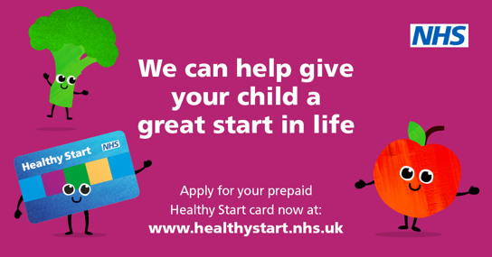
Benefit is delivered on a prepaid card
The benefit is delivered via a prepaid card
The card can be used anywhere that accepts Mastercard® and sells the eligible healthy start food items.
This includes:
  food banks/clubs/pantries
  supermarkets/convenience stores/grocery stores
  drug stores and pharmacies
  markets
  dairy products stores
  newsagents who sell food/petrol stations
You can keep the change or save your money for more items.

Slide 6
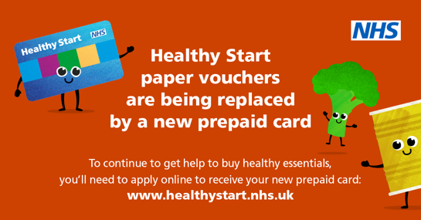
How to use the pre-paid card?
Cards are posted to the registered address once the application is accepted.
The benefit will be automatically added to the card every month
The card must be activated on the automated helpline 0300 330 2090 before you can use it.
The card is contactless but the PIN will be needed first time and sometimes afterwards as a security measure. The PIN can be accessed on 0300 330 2090
The balance can be checked in an ATM on on 0300 330 2090
You must use the card instore, it cannot be used for online shopping.

Slide 7
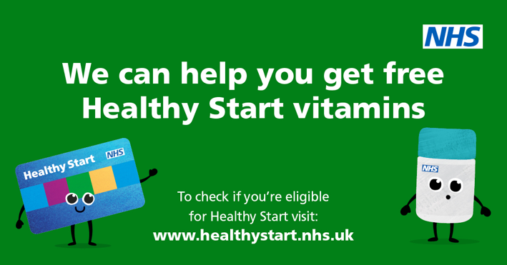
Vitamin collection
The situation with vitamins differs from borough to borough in GM
Midwives/health visitors/GPs will know where you can collect them locally
To collect the vitamins, you simply need to show your card, no money will be taken
Pharmacies who are part of the scheme can be found at nhs.uk/service-search/other-services/Healthy-start-vitamins/LocationSearch/348

Slide 8
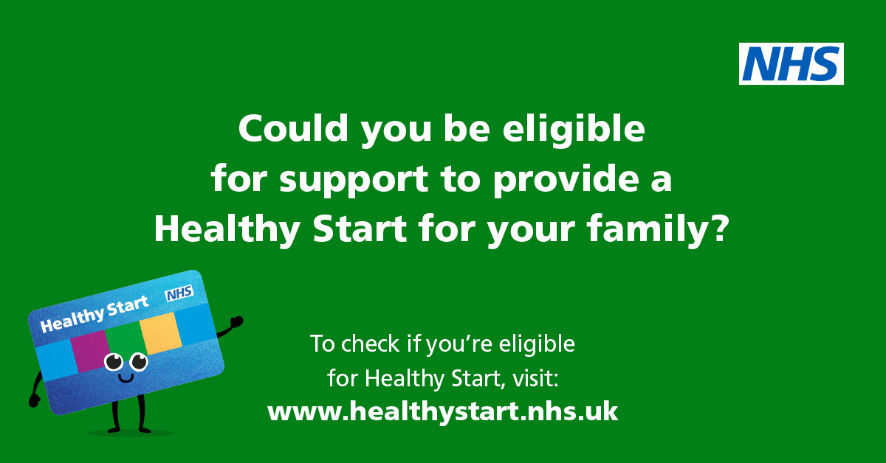
Healthy Start eligibility
Families must be receiving one of the following benefits:
Income Support
Income-based Jobseeker’s Allowance
Pension Credit (must include the child addition)
Universal Credit (only if family’s take-home pay is £408 or less per month from employment)
Child Tax Credit (only if family’s annual income is £16,190 or less)
Pregnant and under 18: qualify regardless of income level
No Recourse To Public Funds – Immigration Status:
At least one British child under 4 years old, and
You have no Recourse To Public Funds (benefits), and
Your family earns less than £408 per month after tax
You can check eligibility at
https://www.healthystart.nhs.uk/how-to-apply/

Slide 9
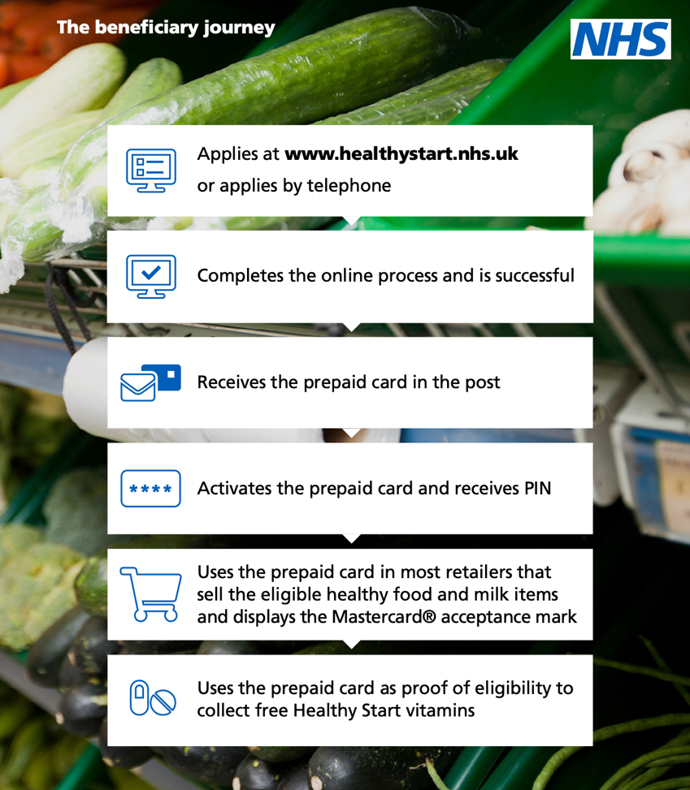
Healthy Start scheme – applying online
If you think you are eligible and you are receiving universal credit or child tax credit, you can apply online.
Applying should be quick and easy:
  Name, Address, Date of birth
  National Insurance Number
  Due date (if relevant)
  Full names and dates of birth of all children under 4
Details must all match exactly the details on your benefit claim. If the details do not match, the system will reject and you will have to update DWP, wait and then try again.

Slide 10
Healthy Start Scheme – other ways to apply
There are people who cannot use the online system and who must apply by email or phone:
  Under 18s
  People on legacy benefits (e.g. income related employment support allowance)
  People eligible because they are receiving pension credit or working tax credit
These groups can apply by emailing healthy.start@nhsbsa.nhs.uk or calling 0300 330 7010
People with no recourse to public funds who may still be eligible for their children can apply on healthystartclaim@dhsc.gov.uk
Citizens Advice or other local advice providers can provide further support if there are difficulties with any application.
https://citizensadvicegm.org/healthystart

Slide 11

Introducing people to Healthy Start – what you can do
There is still a lack of awareness about the scheme. You are in the heart of the community seeing people who might be eligible.
You do not need to be an expert to introduce people to the scheme.
Remember the weekly amount seems small but it can be over £1,200 a child
You can help by putting up information prominently and talking about it telling people how it can help them
If people don’t know how to apply, direct them to the application page and explain the process

Slide 12
Useful Healthy Start contact information
Healthy Start helpline – 0300 330 7010
8am – 6pm Monday – Friday
This can used for general enquiries and applications which cannot be made online.
Activate card, lost card, PIN forgotten, card blocked or balance check - 0300 330 2090
24 hours, 7 days a week
Automated line available at all times.

Slide 13
NHS leaflet available online
Note the new QR code which takes people straight to the online sign up page.

Slide 14
Useful links
How do I check detailed eligibility?
healthystart.nhs.uk/how-to-apply/
Where can I find answers to further questions?
healthystart.nhs.uk/frequently-asked-questions/the-new-healthy-start-scheme/
citizensadvicegm.org/healthystart
Where can I keep up to date with the latest position and raise questions. You can join a national email group at healthy_start-request@lists.riseup.net
Where can I find flyers,leaflets and posters etc. to put up?
media.nhsbsa.nhs.uk/resources/f//nhs-healthy-start-scheme
Where can I find a list of local vitamin distributors?
nhs.uk/service-search/other-services/Healthy-start-vitamins/LocationSearch/348

Slide 15
Thank You for Listening
Jane Partington
Partnership Director at The Bread and Butter Thing

