Slide 1
Introduction to Beeline
Putting you on the path to great jobs in Greater Manchester

Slide 2
Activity
Part 1: List as many jobs as you can.
Part 2: Which of these jobs are needed by organisations (businesses) in Greater Manchester or your local area?

Slide 3
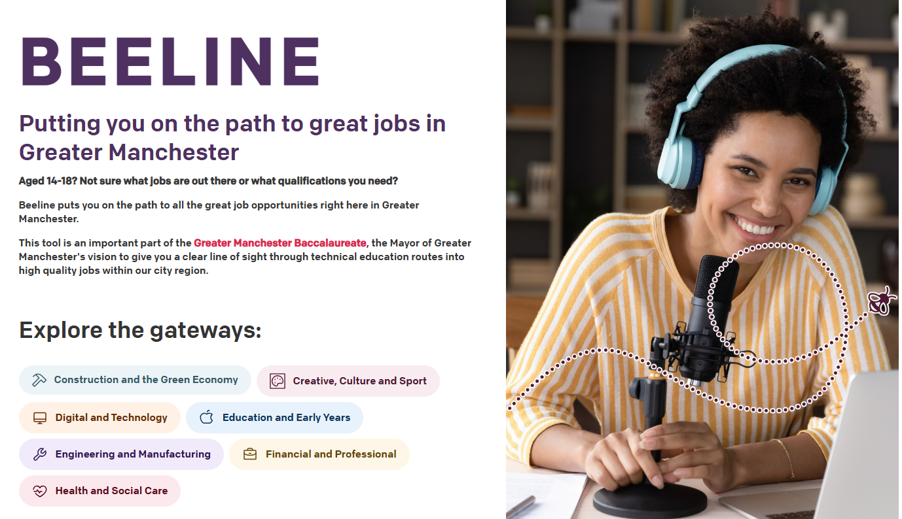
About Beeline
A free digital tool
Idea of the Mayor of Greater Manchester
Gives secondary school and college students a clear view of the jobs available in Greater Manchester and how to get them.
Explore real jobs and salaries
Learn about recommended qualifications and training

Slide 4
Beeline helps you explore ‘gateways’ The Greater Manchester economy is split into different sectors, each requiring different knowledge and skills from its workers. The gateways steer you towards high-quality jobs in Greater Manchester’s growing sectors.
The seven gateways are
Greater Manchester public services
Construction and the Green Economy | Culture, Media and Sport | Digital and Technology | Financial and Professional | Engineering and Manufacturing | Education and Early Years | Health and Social Care

Slide 5
What do other students think of Beeline?

Slide 6
Explore Beeline together
Click to explore Beeline on the GMACS website
Notes:
Directions for demo
Click the link to take you to Beeline on the GMACS website.
Choose a gateway (e.g. Health and Social Care)
Click on ‘explore jobs’
Choose one of the jobs (e.g. social worker). This will take you to the Adzuna website, where you can see the number of jobs available right now in Greater Manchester and the average salary.
Go back to the gateway page on Beeline (Health and Social Care)
Have a look at the GCSEs that would be most beneficial to get this job. Using the example of a Social Worker, what GCSEs might be most relevant?
Then look at what the next step could be, including T Levels and apprenticeships.
Do you know what a T Level is?
A two year course after GCSEs that mixes classroom work with practical job skills.
Do you know what an apprenticeship is?
A free training programme that you do alongside a job. You usually do an apprenticeship after GCSEs.
The next steps are to get a job or continue with training.
Choose one of the jobs you could get at that point (e.g. youth support worker). This will take you to the Adzuna website, where you can see the number of jobs available right now in Greater Manchester and the average salary.

Slide 7
Your task: explore a gateway
Choose a gateway
Write down three jobs available in that gateway
Click on one of the jobs to take you to the Adzuna website
What do you think about the average salary?
How many of these jobs are available in Greater Manchester? Do you think that’s a lot or not much?
Click on one of the job adverts.
Is the salary higher or lower than the average salary?
What else is interesting about this job? Is it full time or part time? Does the job advert say what skills you might need to apply?
Go back to Beeline and click on another job. Follow steps 2 and 3 again.
What similarities and differences do you notice about the different jobs?
Now you’ve explored some jobs, go back to the Beeline gateway page.
What are three of the ‘gateway relevant qualifications’ you might need to be successful in that job?
Can you do an apprenticeship or T Level in this gateway?
Write down three employers you could work for in Greater Manchester

Slide 8
Reflections
What did you learn about different jobs?
Did you learn about a job you hadn’t heard of before?
Which gateway interests you the most, and why?

Slide 9
Useful terms
Term | Definition
Apprenticeship | A free training programme that you do alongside a job. A free training programme that you do alongside a job. There are different levels depending on your previous training or qualifications. There are even apprenticeships that are equivalent to a university degree.
Beeline | A free digital tool to help you explore jobs in Greater Manchester and the qualifications or training needed to get them.
Gateway | Gateways are groups of similar businesses with an increasing number of jobs here in Greater Manchester.
Job advert | A notice that tells people about a job opportunity and the qualifications, training or skills needed to do it. It sometimes includes information on what you will be paid.
Qualification | Proof of skills or knowledge, like passing school tests or exams.
Salary | The money someone earns regularly for doing their job. An annual salary is the total money someone earns from their job in one year.
T Level | A two-year course after GCSEs that mixes classroom work with practical job skills.
Training | Practicing skills or activities to get better at them, maybe by doing a course.
Wage | A wage is the money someone earns for each hour or day they work. Other ways to describe this are “hourly rate” or “weekly pay”.

