Slide 1
The Greater Manchester Baccalaureate (MBacc)
An introduction for educators

Slide 2
Introducing the MBacc
For young people, the university route into a career is clearly set out but the same doesn’t apply for technical education.
Introducing the Greater Manchester Baccaleureate (MBacc)

Slide 3
The MBacc will transform technical education in our city-region
Set out by the Mayor of Greater Manchester, Andy Burnham, the MBacc aims to grow the economy and help all our young people fulfil their potential.
Greater Manchester Combined Authority is working to deliver the 2030 vision in close collaboration with:
Schools & colleges
Partners
Young people
Parents & carers
Employers

Slide 4
Career aspirations
Greater Manchester’s young people have exciting career aspirations.
But do they know how to achieve them?

Slide 5
Seven MBacc gateways align to Greater Manchester’s growing sectors
Each gateway guides young people towards the most relevant knowledge, skills and experience.
The gateways are
Greater Manchester public services
Construction and the Green Economy | Culture, Media and Sport | Digital and Technology | Financial and Professional | Engineering and Manufacturing | Education and Early Years | Health and Social Care
The gateways, informed by local labour market insights, lead to real, high-quality jobs.

Slide 6
Gateway maps help to visualise the journey
Gateway maps highlight:
Relevant subjects to build the knowledge needed for careers in the gateway
The choice of qualifications at each stage
Potential jobs and employers in Greater Manchester
View all
gateway maps on the GMACS website

Slide 7
High-quality jobs await. Beeline puts young people on the path to them.
This digital tool allows young people to explore real jobs and signposts them to the most valued qualifications by Greater Manchester's employers.
Try Beeline on the GMACS website!

Slide 8
The MBacc will open up a clear pathway from school to high-quality jobs in our growing economy
The MBacc aims to be an equally-prestigious alternative for technical education, signposting young people to the subjects Greater Manchester employers value most.
The MBacc is co-designed with some of our city-region’s most prestigious employers

Slide 9
The Greater Manchester economy is booming. Employers need new talent.
Our Employer Integration Board is co-designing the MBacc, so that young people in Greater gain the skills and experience they need to thrive in our city-region.

Slide 10
Getting involved
We encourage you to identify existing activities where this could add value. Think about:
How might you integrate this into your lessons?
How might this help your careers education?
How might this help your work with employers?
How might this inform your options process?
Send your feedback to
mbacc@greatermanchester-ca.gov.uk
How might this support parent and carer engagement?

Slide 11
Find out more or get in touch
Email the team at mbacc@greatermanchester-ca.gov.uk
Access more resources in the Educator Toolkit on the GMCA website

Slide 12
Appendix

Slide 13
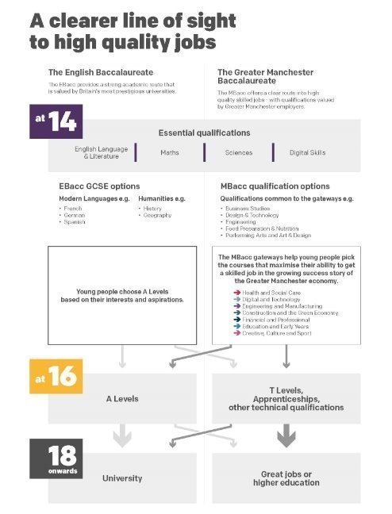
The gateways guide young people on a step-by-step journey from qualifications to high-quality jobs with optionality built-in at every stage
View all
gateway maps on the GMACS website

Slide 14
MBacc year one roadmap (2024/2025)
Key activities for educators
Term 1
Term 2
Term 3
Working with educators and providers to design pilot programmes and raise awareness of the MBacc
Beginning the phased roll out of pilot programmes with young people across the city-region
Celebrating the year's successes and kicking off future activities with the Festival of Technical Education

Slide 15
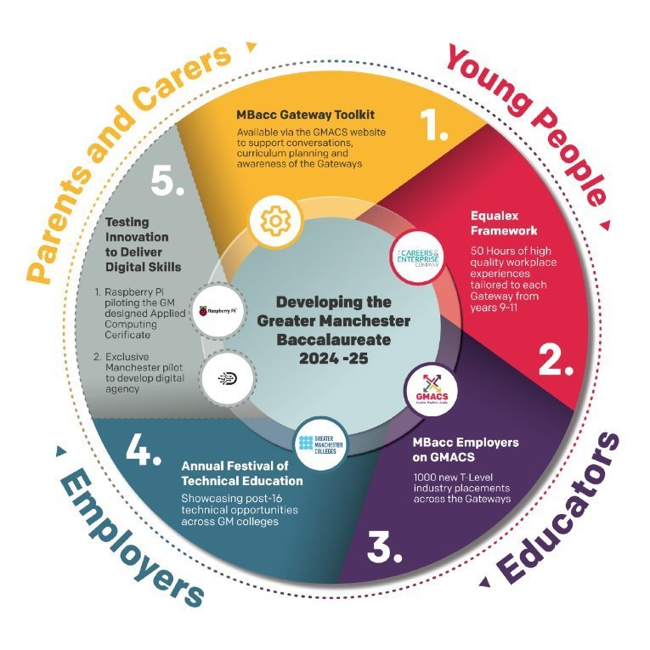
MBacc year one deliverables
(2024/2025)

